Slide 1
USB Rubber Ducky Workshop
Penn State IEEE Student Chapter 2021
Led by Will McGloughlin, Cole Baughman,
Luke Miller, and Taylor Casavant

Slide 2
Go ahead and plug it in!

Slide 3
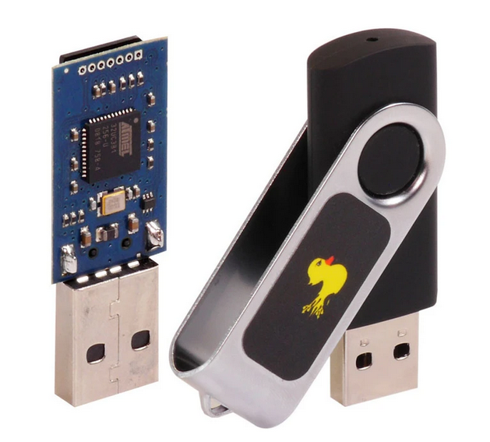
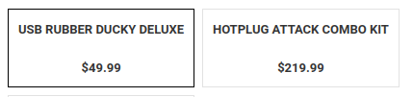
USB Rubber Duckies
Designed to mimic a keyboard/mouse to automate tasks on PCs
More commonly known as “BadUSBs”
Computers inherently and (often) unconditionally trust keyboard and mouse input via USB
If you can do something with just a keyboard, you can automate it with a USBRD
Devices like these are why you NEVER plug in a USB device without knowing what it does
But you guys wouldn’t do that, right?
Rubber Duckies in the wild
Most common commercially available USBRD from Hak5
Disguises itself as a flash drive
Uses custom scripting language
It’s not cheap for what it is
So what did we give you then?

Slide 4
Digispark
ATTiny85-powered Arduino development board
Small
Cheap
Has a male USB port on it
Makes USB HID device imitation trivially easy with the right libraries
Programmed similar to Arduino, with a few key differences
So what?
We can take advantage of the USB HID device libraries to emulate the duties of a real USBRD
Harder to program, but...
Official Hak5 USB Rubber Ducky ---> $50, and you have to learn a new language
Make your own BadUSB device ---> $???, and you have to do that with little support
DIY USB Rubber Ducky w/ Digispark ---> $5, and all you need is Arduino C

Slide 5

Uses
Wide range of uses vary from funny to practical!
Automatically and near-instantly mess with mouse settings
Automatically navigate OS install dialogs
Avoid going AFK with a mouse wiggle or keyboard input
Execute repetitive shell commands
Enter a difficult username/password
Perform any basic, repetitive task
Program to your specific need. Very convenient because it is straightforward and self-contained.

Slide 6
Scarier Applications
All of the following applications come from a single public source dealing specifically in scripts for Digispark. All of these include full scripts, most of which are for use on Windows machines. All of these, if used improperly and/or without permission, hold serious legal consequences.
Fork bomb, both persistent and non-persistent
Keylogger
Reverse Shell
Create a new user
Arbitrary Powershell Execution
DNS Poisoner
Penn State IEEE is not responsible for any damage done to any device using the Digispark Rubber Duckies we give you today.

Slide 7
Ethics
When is it ok to use these scripts?
Pentesting
Hacking a computer system with authorization from the owner
Simulates a real attack
Identifies vulnerabilities
Not uncommon to see BadUSBs in a pentester’s arsenal
On your own device
Make sure you know what your scripts do and how to reverse its effects
NEVER do it on devices that:
You do not own
You are not willing to risk
You are not sure you can fix if something goes wrong
All the scripts we show you will be completely harmless, and pose no risk to your devices.

Slide 8

Programing the Digispark
We will use Arduino IDE to program the Digispark
It supports a dialect of C++, Arduino C
In order to use the IDE we will need to add the Digispark in boards manager and install the driver for it (More on that soon!)
Arduino C is a lower level programing language compared to the languages you may know like Python or Java
Python allows us to be more flexible, for example variable types can be determined at runtime by the data assigned to them
Arduino C code lacks this flexibility
Notes:
GBDK for macos:
KiGB: https://www.macupdate.com/app/mac/11018/kigb/download

Slide 9
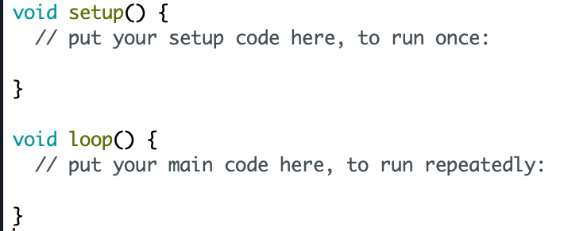
Setup and Loop
When creating a program the Arduino IDE automatically creates two functions
setup() is a place for you to initialize your variables. Runs once.
loop() continuously runs on your Arduino. Runs after setup, forever.

Slide 10
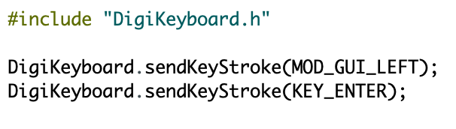
Adding Libraries
Libraries are a collection of non-volatile resources used by computer programs
Existing Libraries for the Digispark will be included in our scripts
They will be written in an include statement at the top of our program
We will use functions from these libraries

Slide 11
Installing Drivers and Adding Boards Manager
Boards Manager URL: http://digistump.com/package_digistump_index.json
Drivers URL: https://github.com/digistump/DigistumpArduino/releases
Notes:
http://digistump.com/wiki/digispark/tutorials/connecting

Slide 12
Installation and Testing

Slide 13
Example One:
The Rickroll

Slide 14
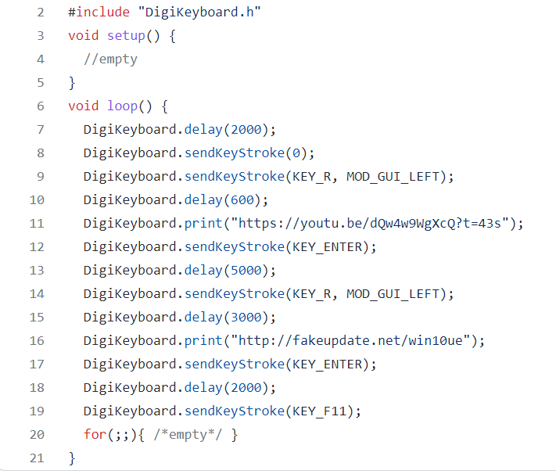
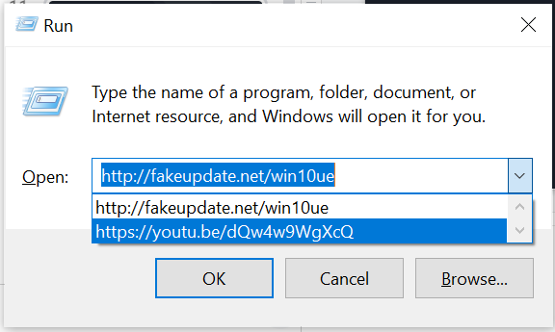
Rickroll / Fake windows update

Slide 15
Example Two:
The Mouse Wiggler

Slide 16
Make something cool!
The Committee will be here to help!

